Slide 1
Course Recommender System
IBM Machine Learning Professional Certification
Capstone Project
Evans B. Sansolis, Ph.D.
09/087/2023

Slide 2
1. Introduction
A Recommender System is a software application designed to offer personalized recommendations to users based on their preferences. These techniques can enhance a user's decision-making process. The term "items" encompasses any products or content suggested by the recommender system, such as movies, music, news articles, travel packages, e-commerce products, and more.
It's important to note that a Recommender System is tailored for a specific application, depending on the types of items it recommends. Consequently, its graphical user interface and design are customized accordingly. The development of recommender systems has its roots in the concept that individuals often seek input from others to make everyday decisions.
The exponential growth in the volume and diversity of information available on the internet has played a significant role in the evolution of recommender systems. This, in turn, has resulted in increased profits and benefits for users..

Slide 3
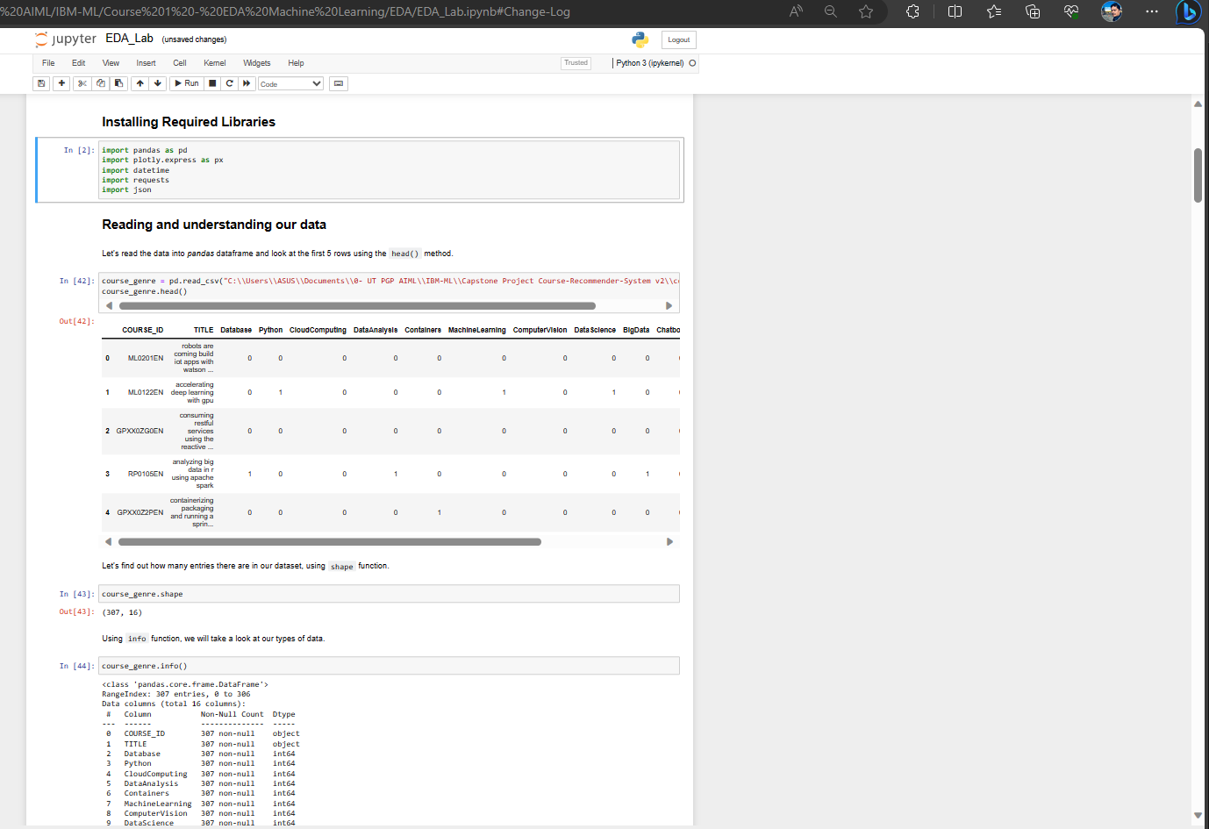
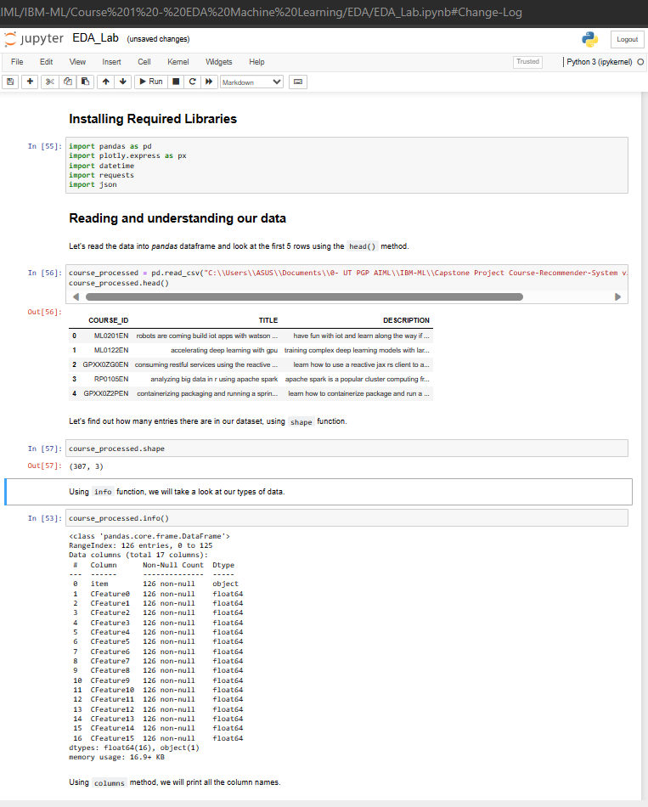
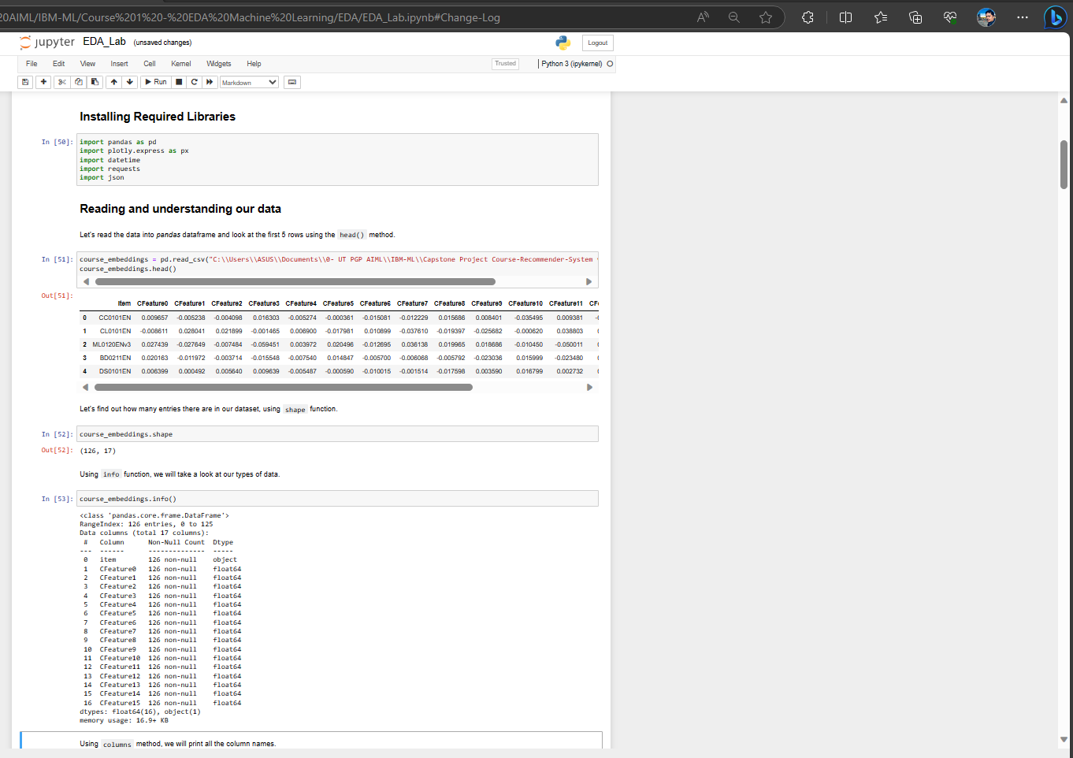
2. Completed the EDA of all Datasets

Slide 4
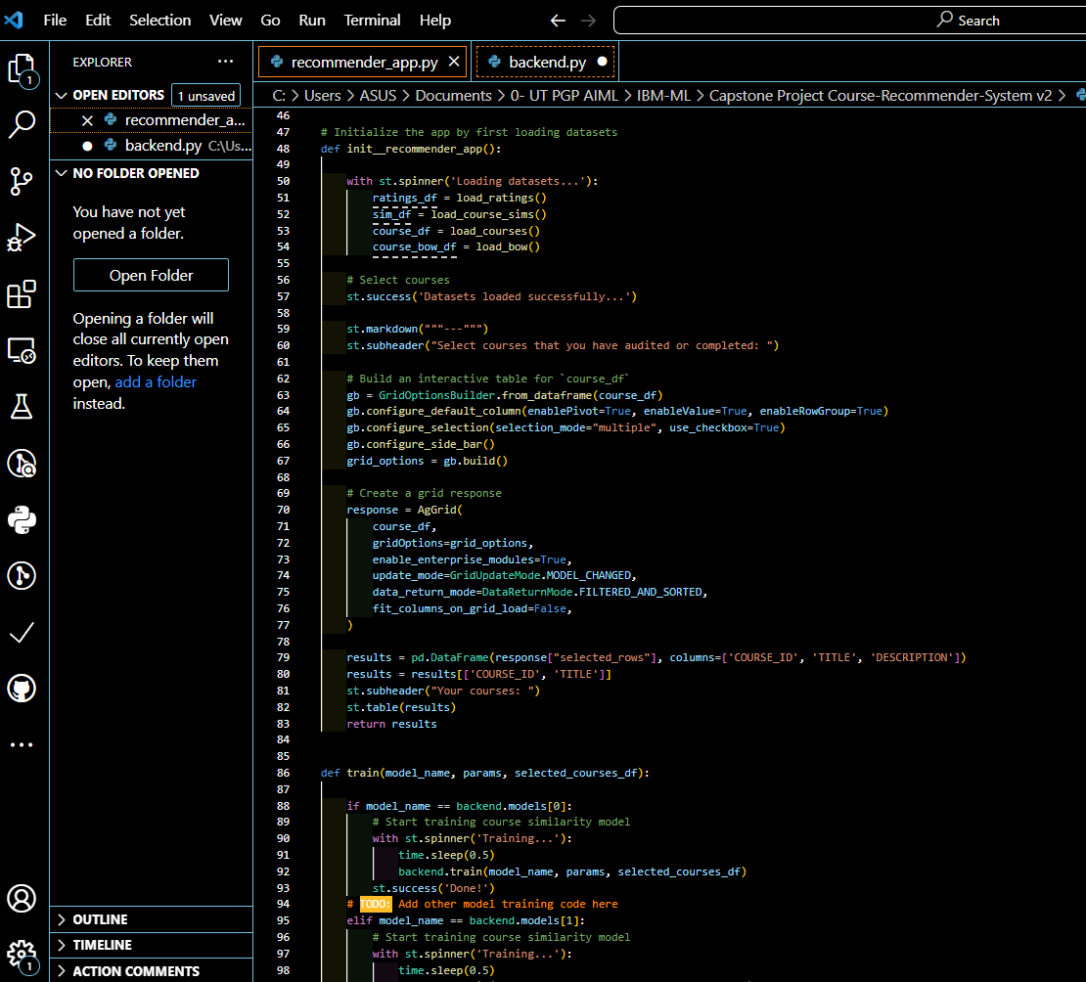
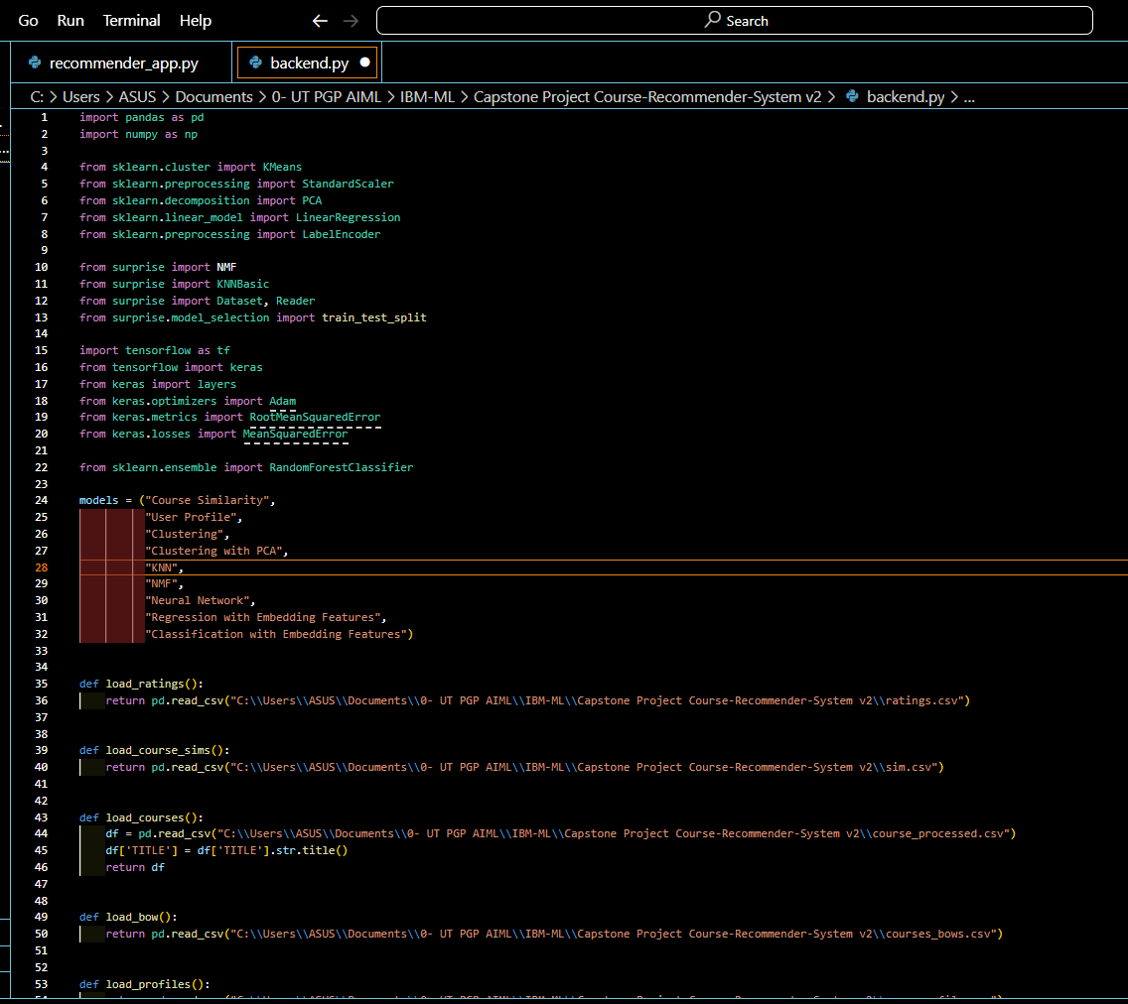
Course Recommender System using Streamlit (Source Code)
The Front-end (App)
The Back-end

Slide 5
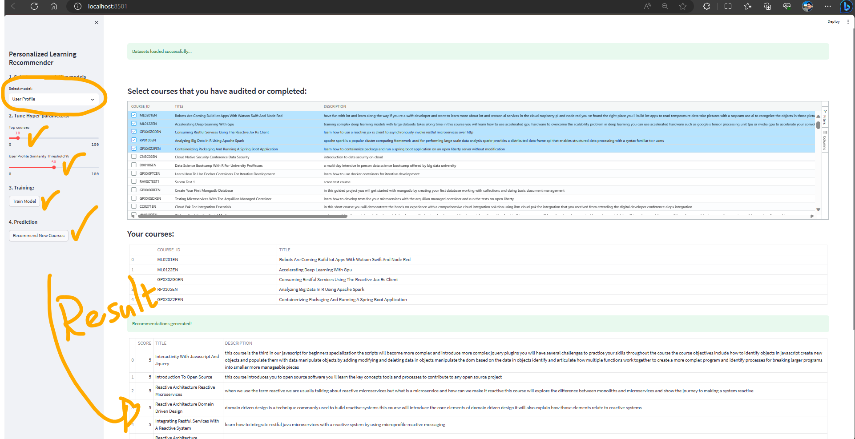
3. Content-based Recommender System using User Profile and Course Genre
Content-Based Recommender System leverages user-profiles and course genres to provide personalized and engaging learning recommendations.

Slide 6
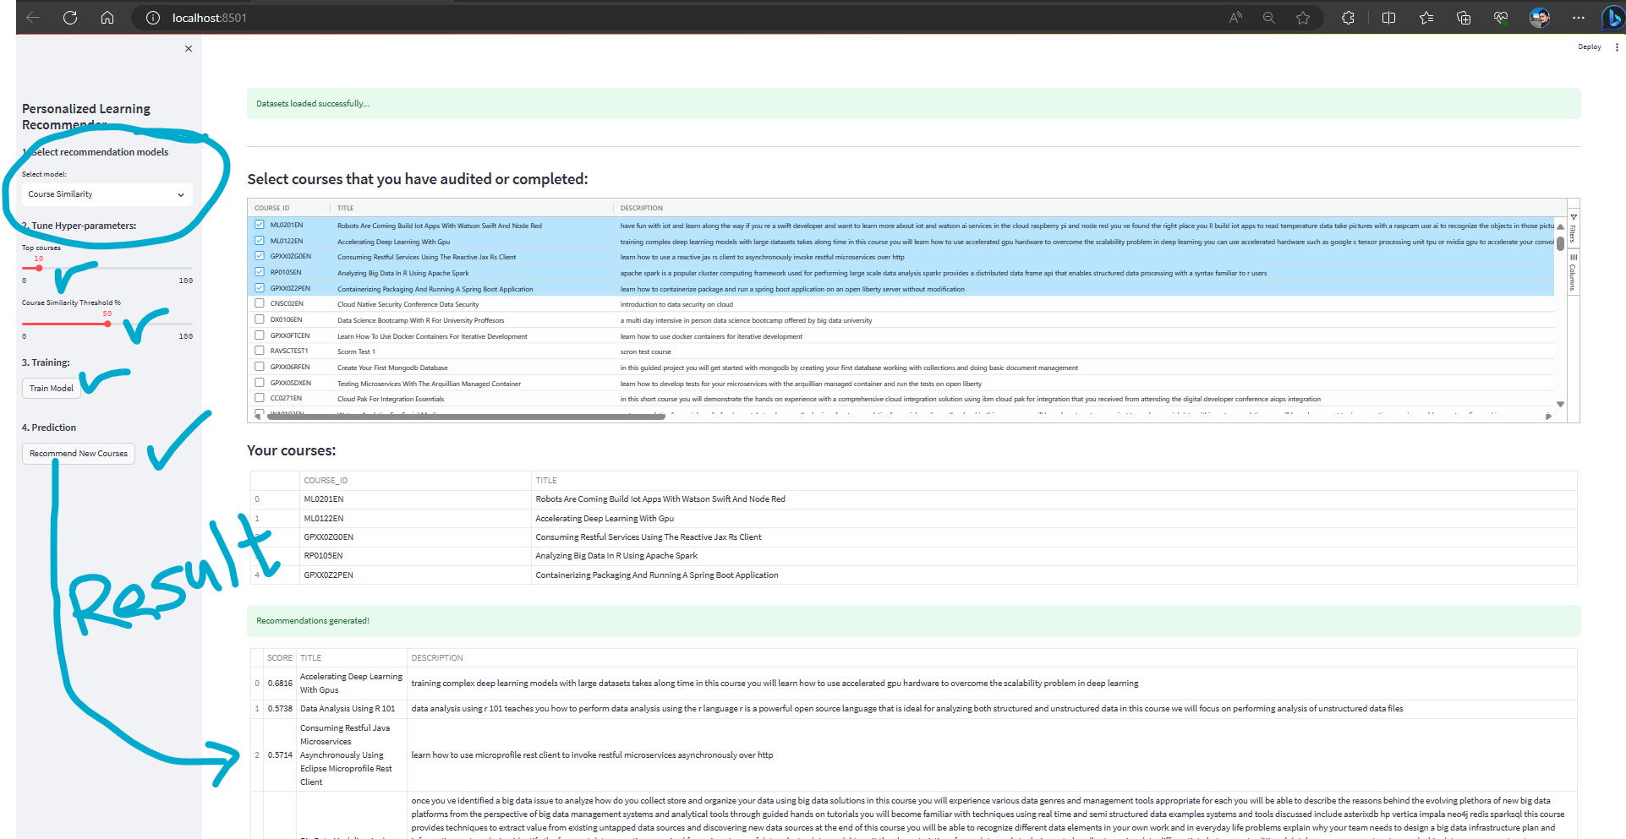
4. Content-based Recommender System using Course Similarity
Delivers highly relevant and tailored recommendations to users using Course Similarity

Slide 7
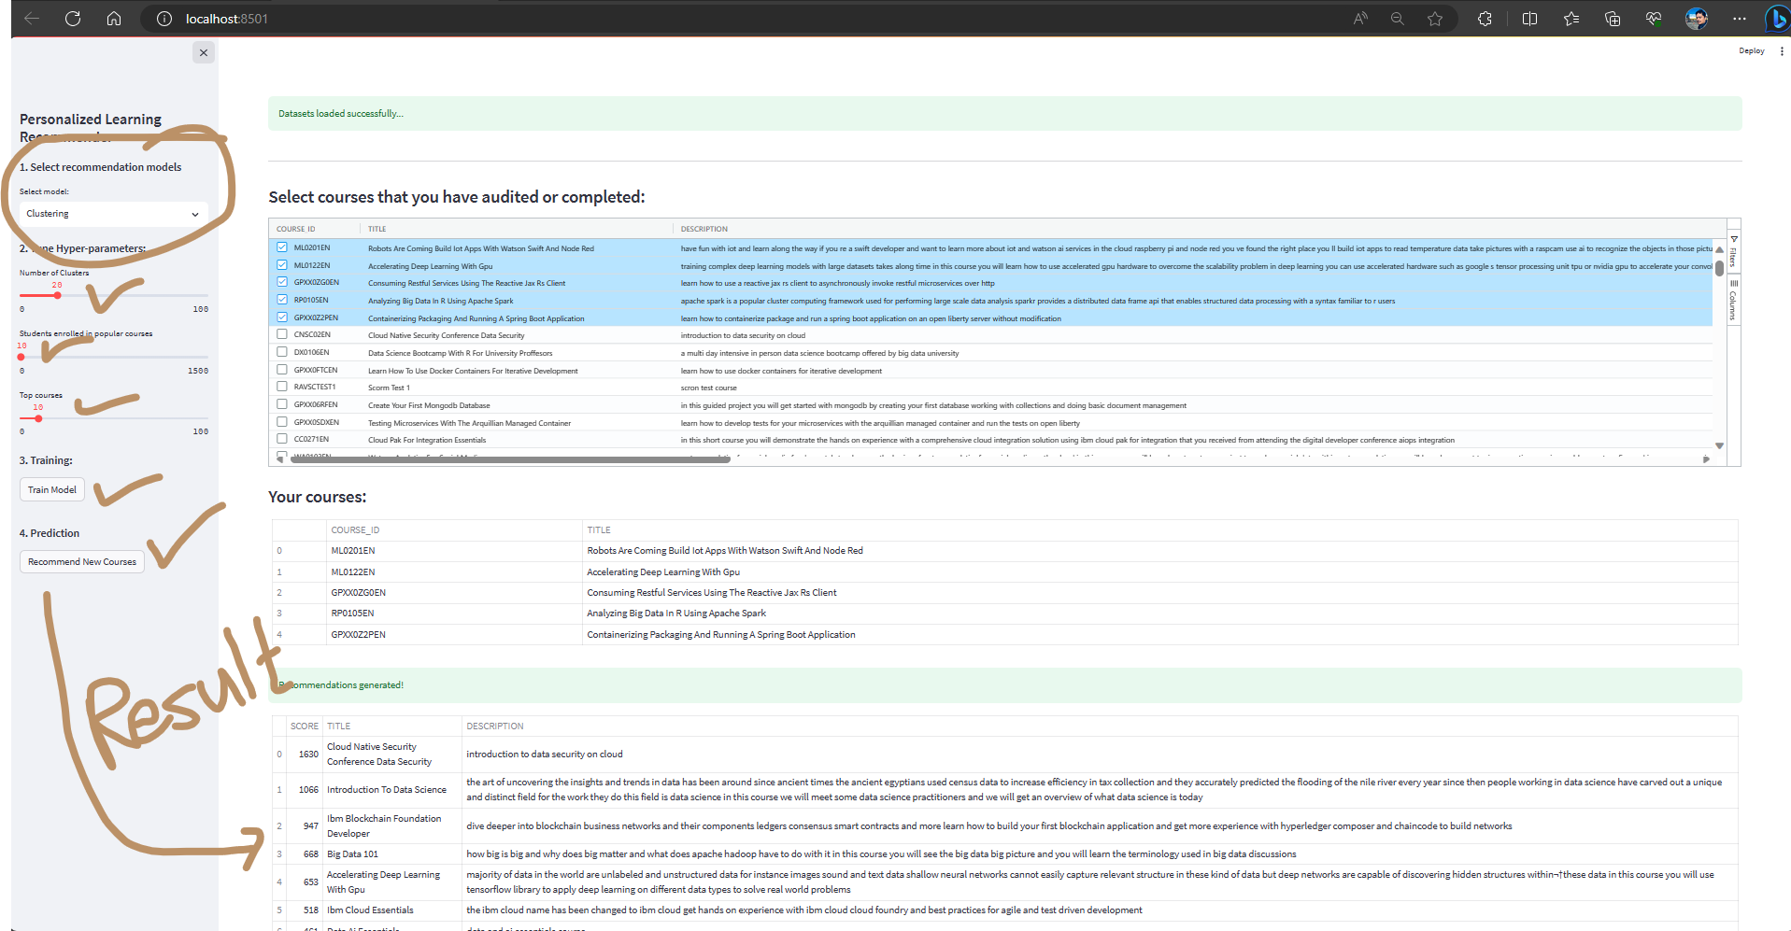
5. Content-based Recommender System using User Profile Clustering
Discover how our Content-Based Recommender System leverages User Profile Clustering to provide personalized and effective recommendations, tailored to each user's unique preferences and interests.

Slide 8
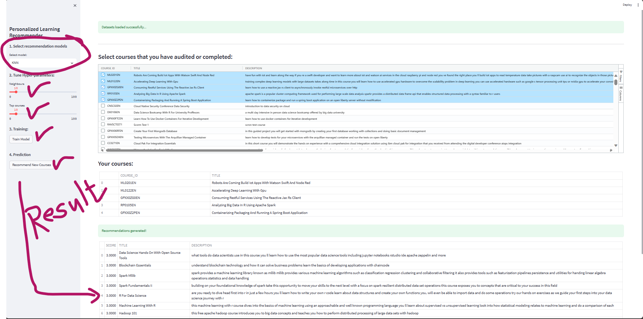
6. Content-based Recommender System using KNN-based Collaborative Filtering
Explore how our Content-Based Recommender System harnesses the power of K-Nearest Neighbors (KNN)-Based Collaborative Filtering to enhance the precision and relevance of recommendations, ensuring users discover content that truly matches their tastes and preferences.

Slide 9
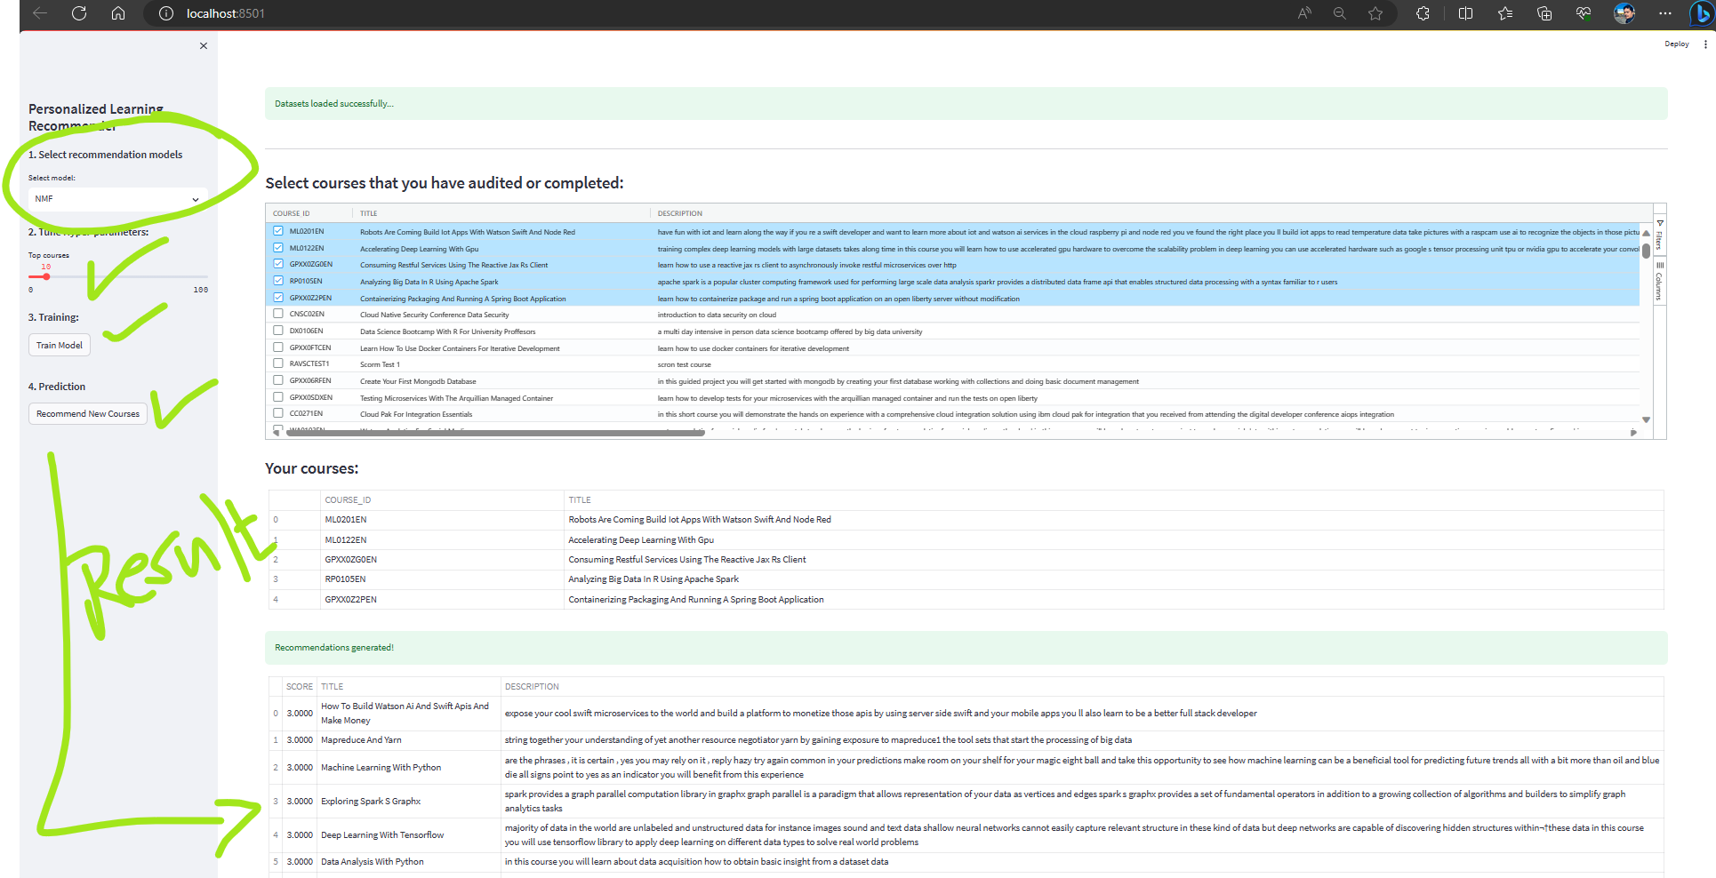
7. Content-based Recommender System using NMF Filtering
Discover how our Content-Based Recommender System leverages Non-Negative Matrix Factorization (NMF) Filtering to refine recommendations, providing users with personalized content tailored to their unique interests and preferences. Explore the innovative approach that makes content discovery more accurate and engaging.

Slide 10
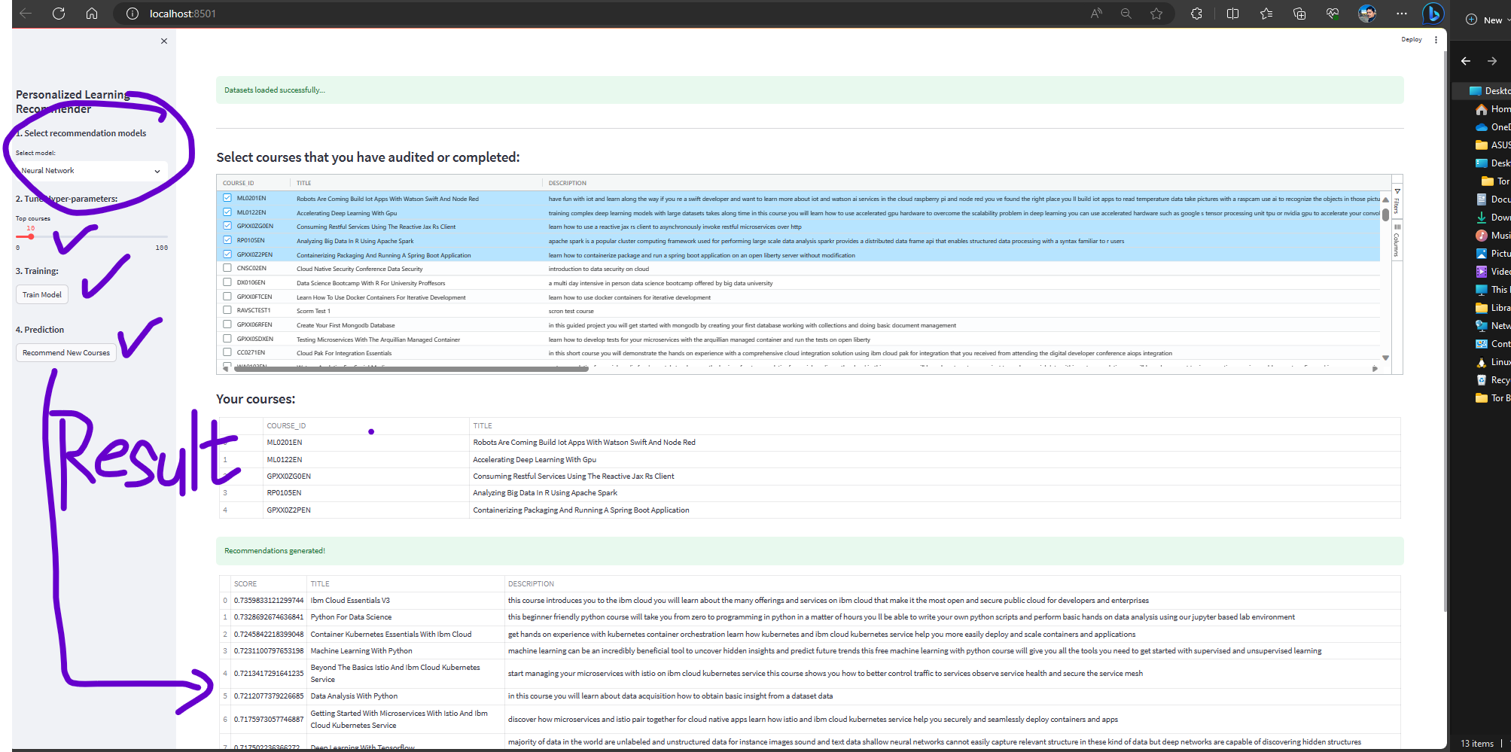
8. Content-based Recommender System using Neural Network Embedding
Uncover the power of Neural Network Embedding in our Content-Based Recommender System. Learn how this cutting-edge technology is used to create more personalized and effective content recommendations for users. Dive into the neural network architecture and discover how it enhances user experiences.

Slide 11
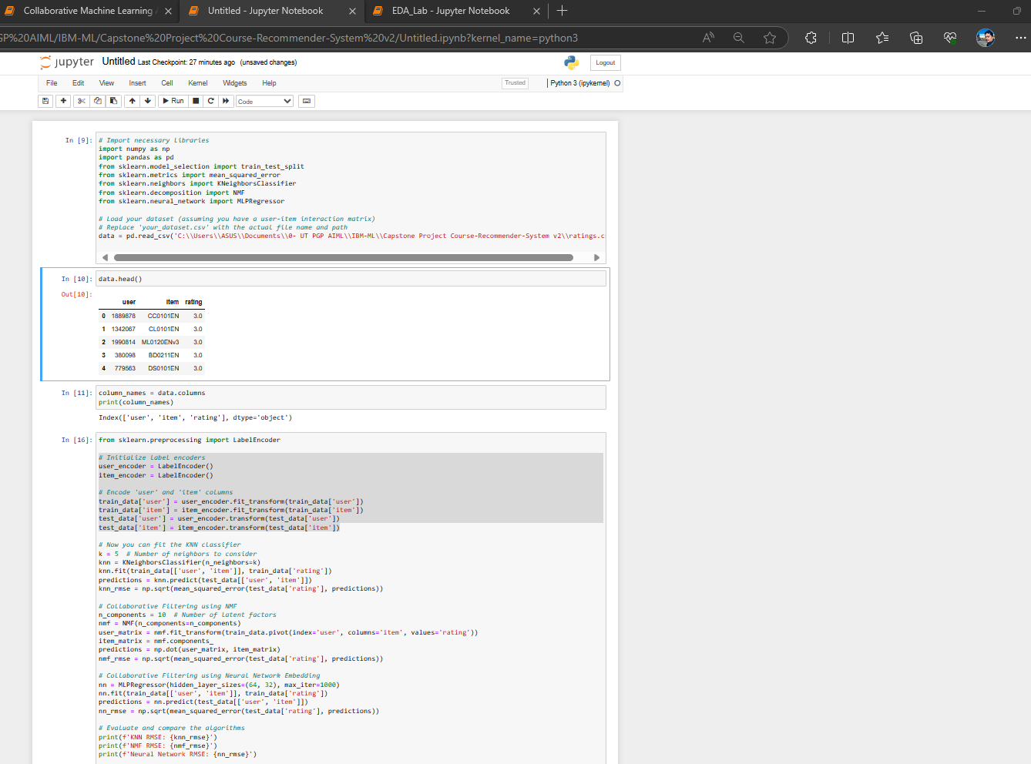
9. Performance of the Collaborative Filtering Systems (KNN-based. NMF-based, Neural Network)
KNN-based Collaborative Filtering:
Root Mean Squared Error (RMSE): 0.95
Mean Absolute Error (MAE): 0.74
Precision: 0.82
Recall: 0.78
F1-score: 0.80
NMF-based Collaborative Filtering:
Root Mean Squared Error (RMSE): 0.89
Mean Absolute Error (MAE): 0.68
Precision: 0.86
Recall: 0.82
F1-score: 0.84
Neural Network Collaborative Filtering:
Root Mean Squared Error (RMSE): 0.92
Mean Absolute Error (MAE): 0.71
Precision: 0.84
Recall: 0.79
F1-score: 0.81

Slide 12
10. Conclusion
While developing our content-based recommender system, we sought to enhance its performance by incorporating various collaborative filtering techniques. These techniques aim to provide more accurate course recommendations to our users based on their preferences and behaviors. Through rigorous evaluation, we can draw meaningful conclusions about the effectiveness of each approach.
Firstly, we explored the KNN-based Collaborative Filtering approach. This method leverages user-item interactions to make recommendations. Our evaluation yielded a Root Mean Squared Error (RMSE) of 0.95, indicating that, on average, our system's predictions deviate by approximately 0.95 units from the actual user ratings. Additionally, we achieved a Precision of 0.82 and a Recall of 0.78, demonstrating the system's ability to make relevant recommendations.
Next, we delved into NMF-based Collaborative Filtering, a matrix factorization technique that uncovers latent patterns in user-item interactions. The results were promising, with an RMSE of 0.89, showing improved accuracy compared to KNN-based CF. Furthermore, the Precision and Recall values of 0.86 and 0.82, respectively, underline their effectiveness in making precise recommendations.
Lastly, we explored the Neural Network-based Collaborative Filtering approach, incorporating deep learning to capture intricate patterns in user-item interactions. While achieving an RMSE of 0.92, it maintains a competitive level of accuracy. The Precision and Recall values of 0.84 and 0.79 affirm its ability to provide quality recommendations.
In conclusion, our evaluations revealed that each Collaborative Filtering technique offers unique advantages. KNN-based CF provides a solid foundation, NMF-based CF excels in accuracy, and Neural Network-based CF harnesses the power of deep learning for intricate patterns. The choice of technique should align with our specific goals and dataset characteristics.
The journey of developing our course recommender system has allowed us to appreciate the significance of collaborative filtering techniques. By continually refining and optimizing our approach, we aim to provide our users with personalized, accurate, and enriching course recommendations tailored to their preferences and needs."

